Slide 1
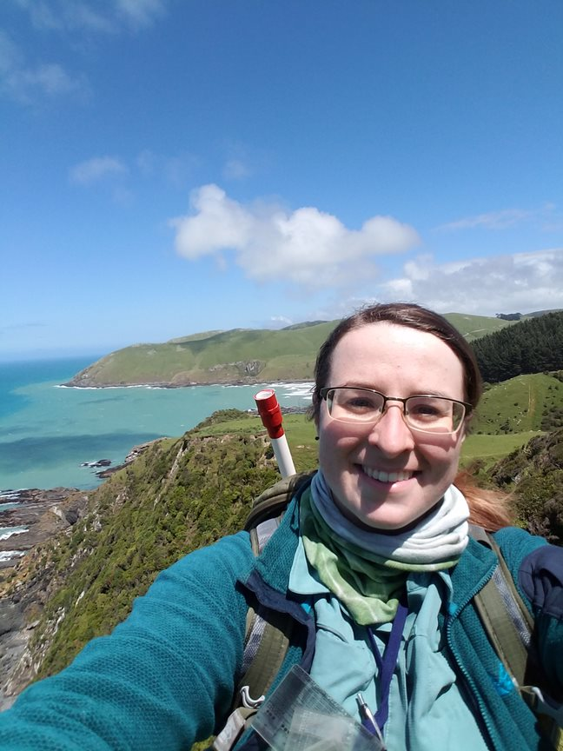


Slide 2
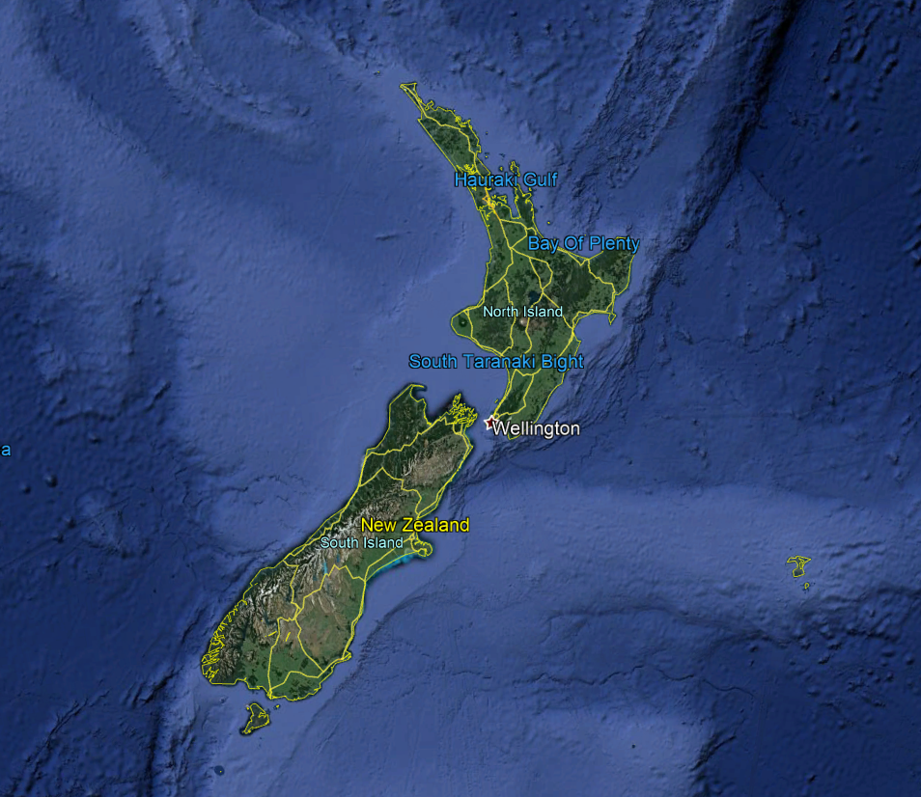

Slide 3
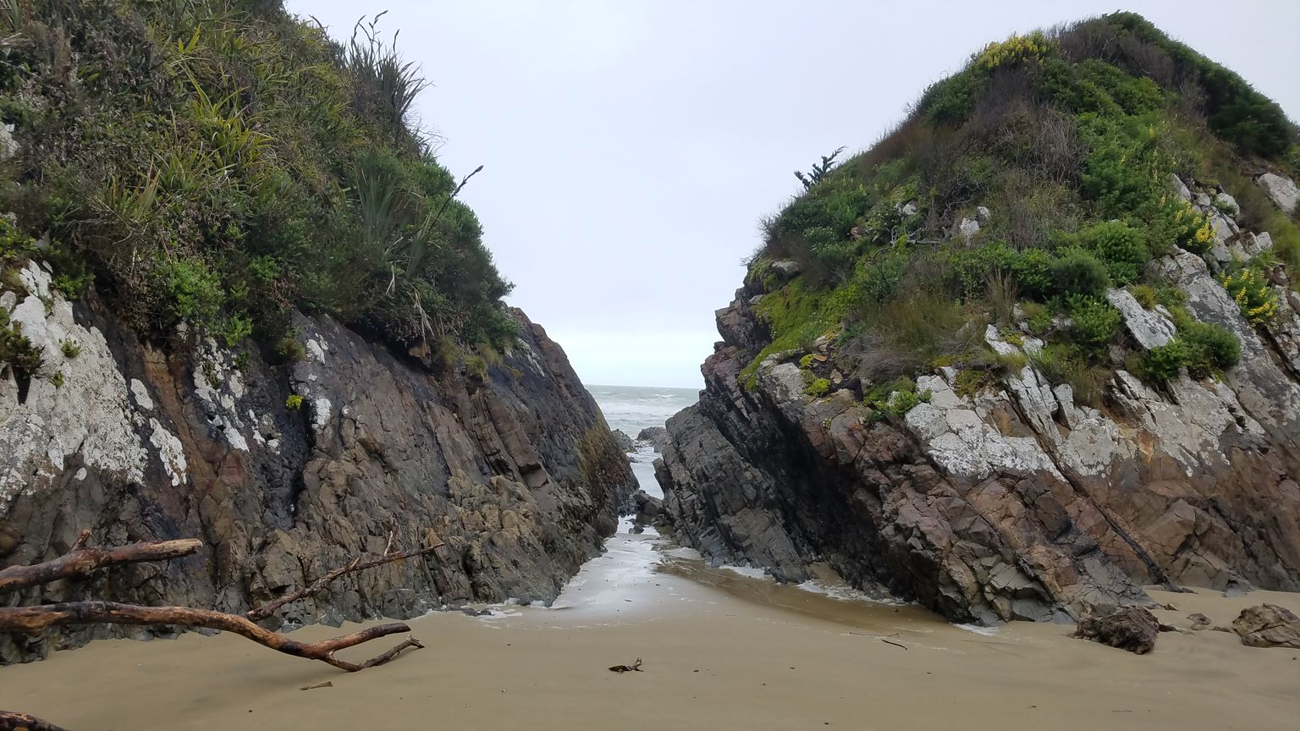
Pore Water Geochemistry of the Late Triassic Taringatura Sandstone of New Zealand
Annaka M. Clement
NDSU Geochemistry 2018

Slide 4
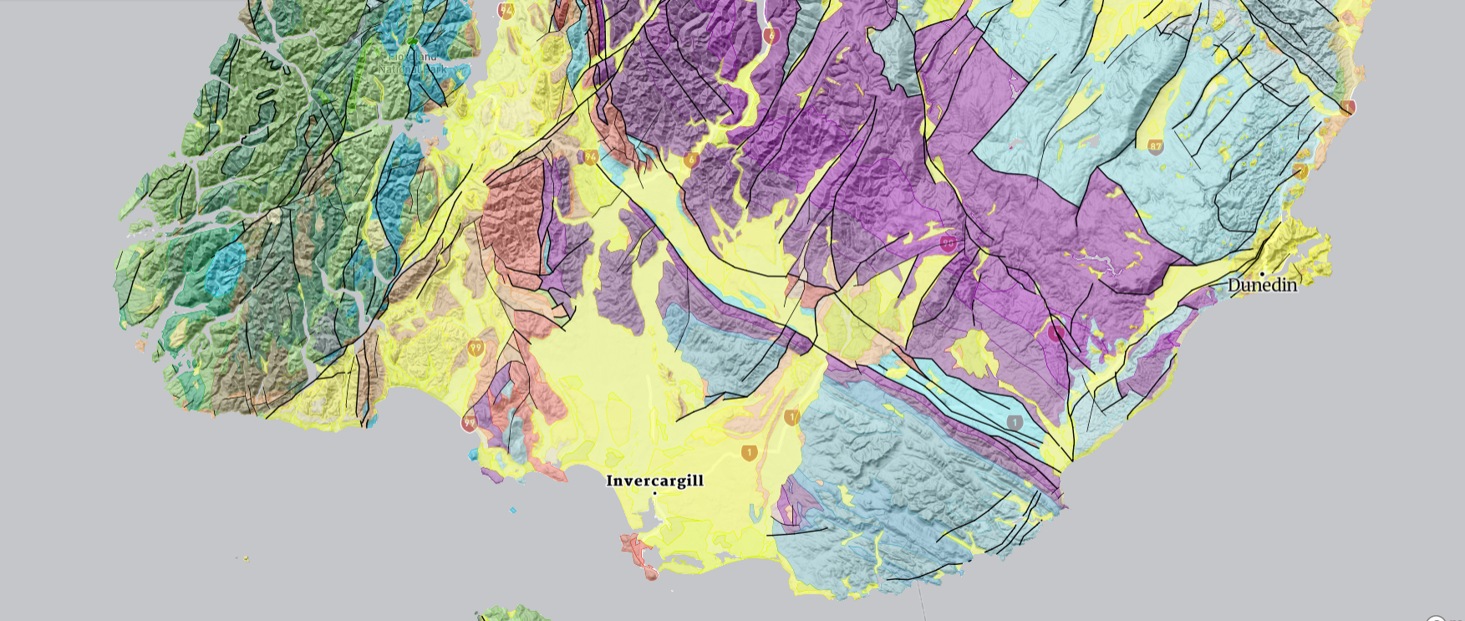

Slide 5
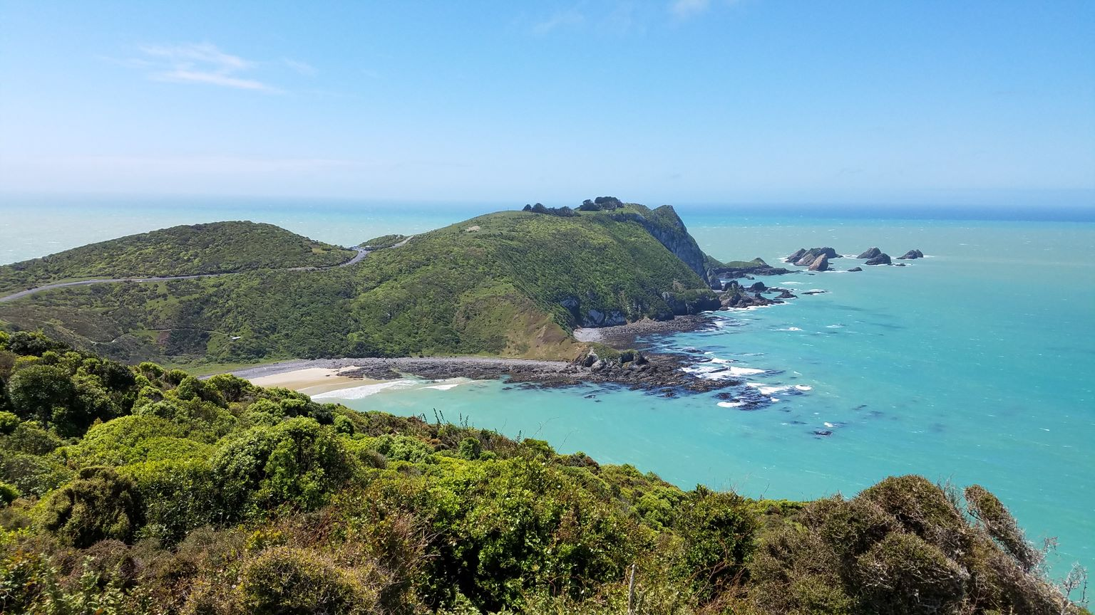

Slide 6
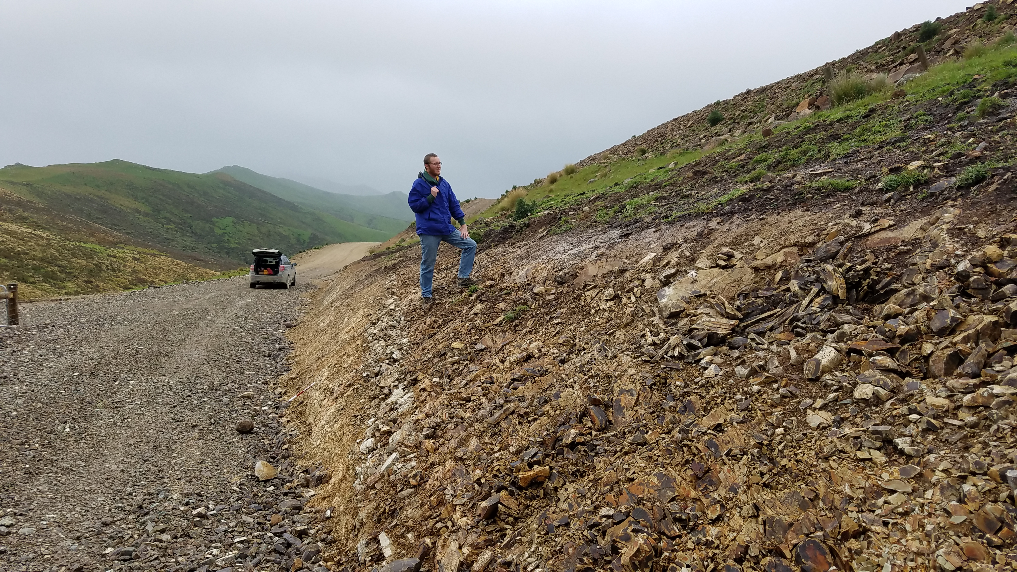

Slide 7
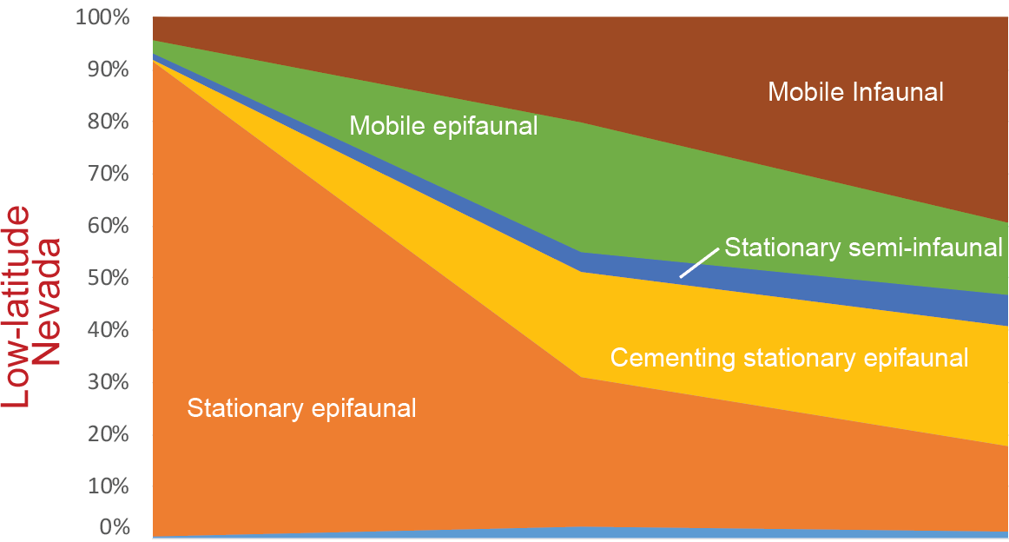
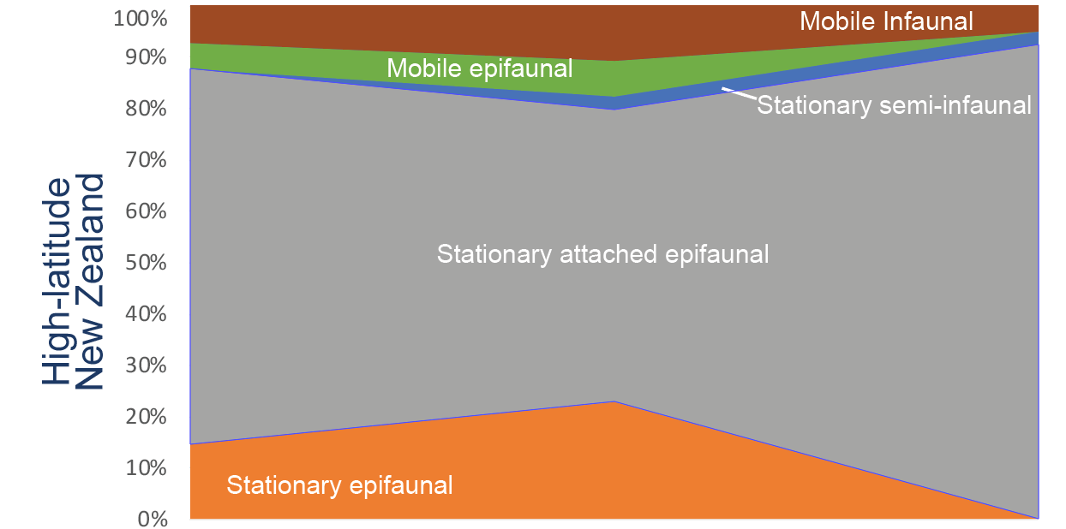
Why Bother?
Early Norian Late Norian
Early Norian Late Norian
(Tackett & Bottjer 2016)

Slide 8
Why so few New Zealand burrowers?
We have not sampled enough yet?
Carbonate vs. siliciclastic substrate?
Latitude (temperature) control?
Poor preservation in New Zealand?
Inhospitable pore water geochemistry?

Slide 9
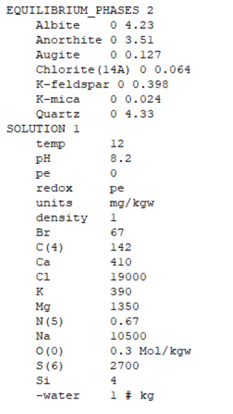
Batch reaction with a lot of back-story
Composition given in modal %
What do you do when the database does not have your mineral?
Seawater is not pure water
Oxygen attenuation and redox zones
Batch reaction + a diffusion reaction?

Slide 10
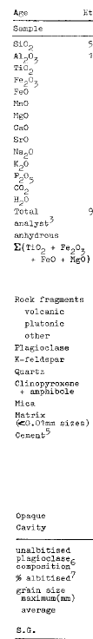
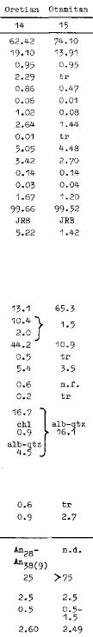
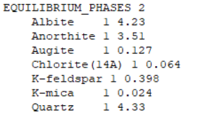
Initial PHASE data
Simplified to per 1m³ of sandstone
976.51g Anorthite
1107.47g Albite
398.26g Quartz
110.59g Orthoclase
42.9g chlorite
30.68g Augite
9.27g Biotite
(Boles 1974)
Modal %
Volume (cc)
Grams
Moles

Slide 11
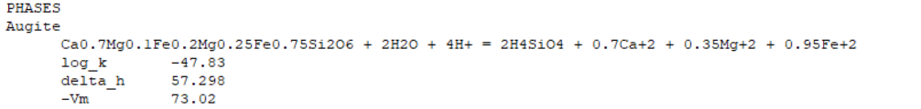
What to do when the databases do not have your mineral?
You get to program!
PHASE has a lot of potential inputs, but the following are non-optional
balanced dissolution formula
log K at 25°C (calculated from ΔG of reaction) (Robie et al. 1979)
ΔH of reaction
-molar volume (Vm: molecular weight/density at 25°C)

Slide 12
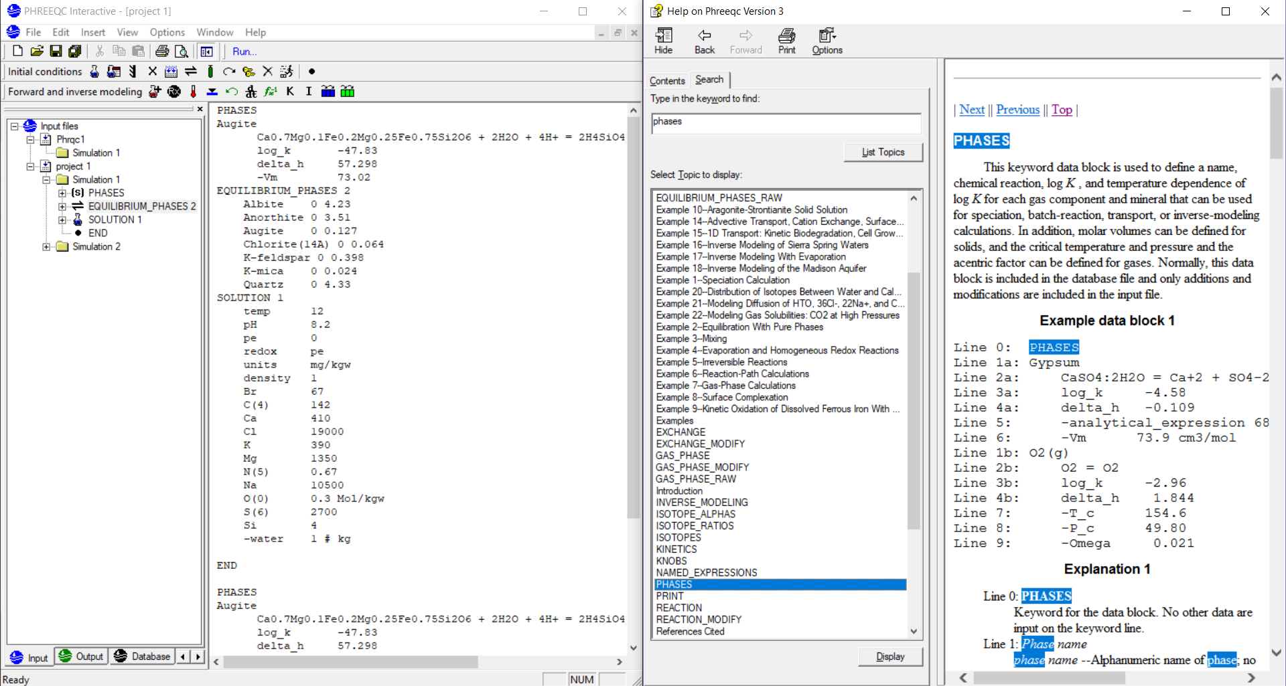

Slide 13
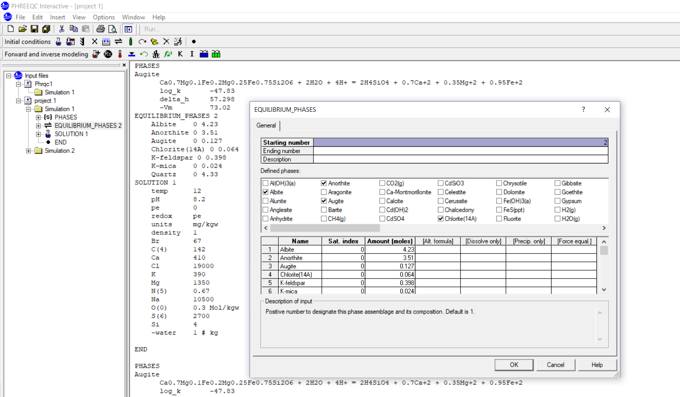

Slide 14
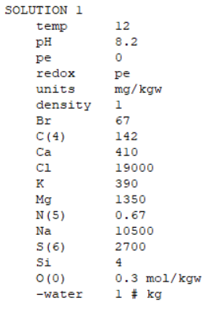
Initial SOLUTION: seawater
The ocean is not pure water, so instead use
essentially modern New Zealand seawater. (Callander et al. 2011)

Slide 15
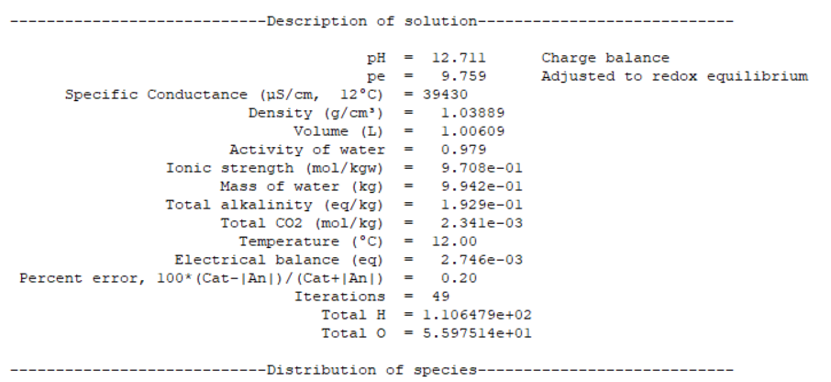
Results
The high pH was a little surprising.
Modern burrowing clams have a pH tolerance range of 7 – 9 (Mulholland 1984)

Slide 16
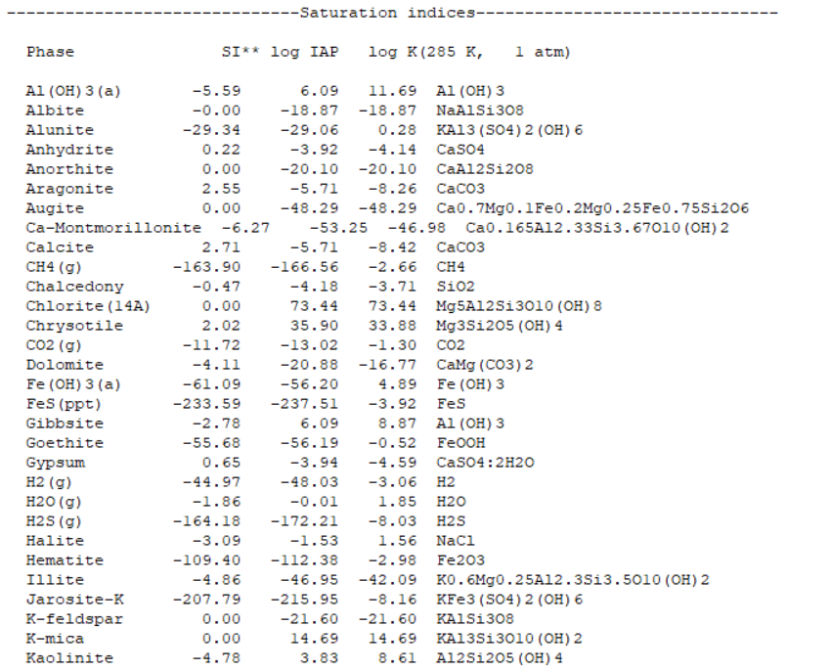
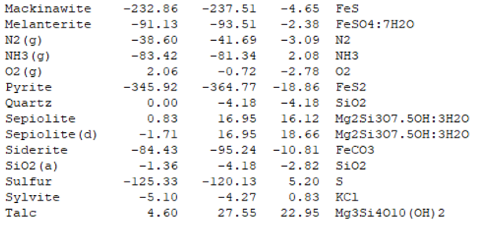
Results

Slide 17
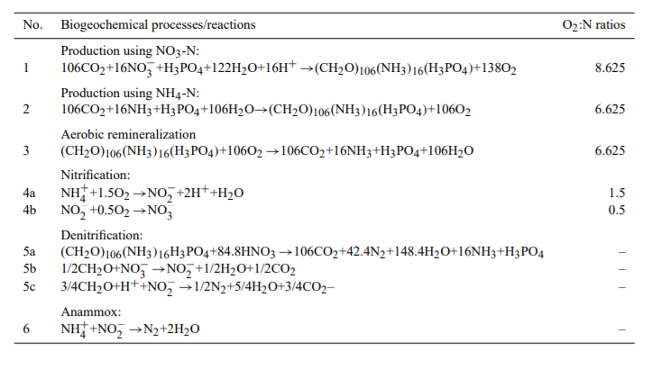
Things in progress
Diffusion of oxygen into a sediment column- TRANSPORT
Redox reactions caused by life
(Peña et al. 2010)

Slide 18
Things that should eventually be addressed
Does grain size make a difference?
Tracking sandstone composition changes through time
Matrix material not considered in this analysis

Slide 19
Thank you for your attention!
I hope all the recordings turned out alright!

Slide 20
References
Boles, J. R. (1974). Structure, stratigraphy, and petrology of mainly Triassic rocks, Hokonui Hills, Southland, New Zealand. New Zealand journal of geology and geophysics, 17(2), 337-374.
Callander, P., Lough, H., and Steffens, C., 2011, New Zealand Guidelines for the monitoring and management of sea water intrusion risks on groundwater: prepared for Envirolink Project 420-NRLC50
Peña, M. A., Katsev, S., Oguz, T., & Gilbert, D. (2010). Modeling dissolved oxygen dynamics and hypoxia. Biogeosciences, 7(3), 933-957.
Robie, R. A., Hemingway, B. S., & Fisher, J.R. (1979). Thermodynamic properties of minerals and related substances at 298.15 K and 1 bar (10⁵ pascals) pressure and at higher temperatures. U.S. Geological Survey Bulletin 1452.
Tackett, L. S., & Bottjer, D. J. (2016). Paleoecological succession of Norian (Late Triassic) benthic fauna in eastern Panthalassa (Luning and Gabbs formations, west-central Nevada). Palaios, 31(4), 190-202.

