Slide 1
Application of zeolitic volcanic rocks for arsenic removal from water
F. Ruggieri, V. Martin, D. Gimeno, J.L. Fernandez-Turiel, M. Garcia-Valles, L. Gutierrez
Presented by Sharon Brozo and Jason Triplett

Slide 2
Introduction
Article information
Background and Methods
Topic discussion
Arsenic
Zeolite
Modeling completed
Modeling attempted
Conclusion & questions

Slide 3
Article Review Application of zeolitic volcanic rocks for arsenic removal from water
Explore the effectiveness of removing arsenic (As), Potentially Toxic Trace Element (PTTE) from natural waters
Research is needed to explore the ability of zeolites to “filter” natural waters during treatment vs high cost methods
High cost alternatives
Activated carbon
Chitosan
(Ruggieri et al, 2008)

Slide 4
Methods/Materials
8 zeolite rich rocks from different locals were crushed/filtered to a size of <200 µm
Zeolites identified were Clinoptilolite, Chabazite, Phillipsite, Mordenite
2 g of each ground material was exposed to 100ml of 5 different waters
1 deionised water with 101 µg l ¹⁻ As
4 different natural waters with As concentrations ranging from 102-105 µg l ¹⁻
(Ruggieri et al, 2008)

Slide 5
Findings
Highest rate of As removal varied from 40 to 78% within the natural waters
Depending on rock/zeolite and water chemistry
Highest with Chabazite and Phillipsite
Lower clinoptilolite show better removal
Overall, efficiency increased with mineralization of water
(Ruggieri et al, 2008)

Slide 6
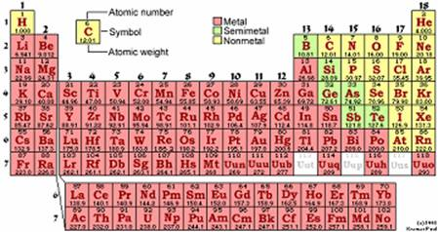
Arsenic
http://www.chemprofessor.com/ptable.htm
Metalloid
Group 5A
Period 4
One of the most common PTTE
Exists in Organic and Inorganic forms
Organic more toxic then Inorganic
Has two oxidation states
Trivalent - As(III) & Pentavalent - As(V)
As(III) more toxic then As(V)
Dependent on pH
(Jeon at al, 2008)

Slide 7
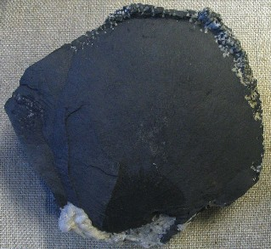
Arsenic
Occurs in environments through both natural means and by anthropogenic activity
Natural occurrences
Mineral leaching
Volcanic activity
Natural fires
Human activity
Ore processing
Agricultural applications
Wood preservatives
Coal combustion
http://z.about.com/d/chemistry/1/0/J/Q/arsenic.jpg
(Ruggieri et al, 2008 & www.epa.gov/safewater/arsenic/basicinformation.htm)

Slide 8
Arsenic
Health Risks due to intake of arsenic by food and/or water consumption
Short Term (High doses)
Headache, upset stomach, naseau,etc
Long term
Carcinogenic – Cancers of the skin, lungs, liver, kidney, bladder, and prostate (to name a few)
Arsenic concentrations
Allowable limit 10 µg l ¹⁻ (10 ppb)
Maximum limit 50 µg l ¹⁻ (50 ppb
(www.epa.gov/safewater/arsenic/basicinformation.htm)

Slide 9
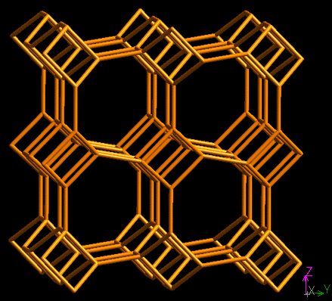
Zeolites
Framework Silicate
Hydrated aluminosilicates
Crystaline solids
Composed of Interlocking SiO₄ & AlO₄ tetrahedra
Rigid
3-dimensional
Microporous
http://www.iza-structure.org/databases/
(http://www.bza.org/zeolites.html)

Slide 10
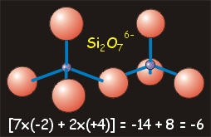
Due to structure, overall charge becomes negative
Attracting different cations to the structure
K⁺, Ca+, Na⁺
(http://academic.brooklyn.cuny.edu/geology/powell/core_asbestos/geology/silicates/bonding/silicate_bond.htm)

Slide 11
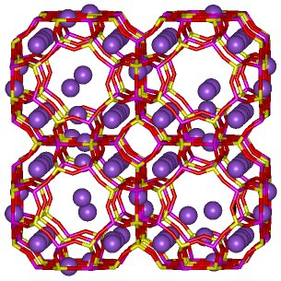
Ion Exchange with Zeolites
Because of the weak bound nature of the metal ions (K⁺, Ca⁺, Na⁺), other metal cations will often be exchanged when in an aqueous solution.
This is the basis for using Zeolites to remove arsenics (As^{+3,+5}) from waters
Na in purple
(http://www.bza.org/zeolites.html)

Slide 12
Modeling
We first wanted to see what the models would look like for the given water chemistry for comparative purposes.
Because As was not available in the phreeqc data base, we had to use the wateq4f.dat base that is located in the phreeqC folder.
The wateq4f.dat base is a revised data base that has an additional 20+ compounds, ions, and trace elements to choose from for the water chemistry, including arsenic.
Explained in Attachment B of Phreeqc User Guide
(PhreeqC - ftp://brrftp.cr.usgs.gov/geochem/unix/phreeqc/manual.pdf)

Slide 13
Water Chemistry
Characterization of water samples - from Table 2 (Ruggieri et al, 2008)
 | Units | W0 | W1 | W2 | W3 | W4
Ca | mg/L | 0.8 | 6.6 | 46.1 | 47.5 | 102
Mg | mg/L | 0.1 | 1.1 | 8 | 9.3 | 30.7
Na | mg/L | 0.3 | 7.3 | 13.6 | 20.4 | 181.2
K | mg/L | 0.5 | 0.2 | 1.4 | 3.4 | 39.6
Si | mg/L | 0.6 | 4.5 | 4.9 | 1.5 | 1.5
Cl | mg/L | <0.1 | 1.8 | 7 | 30.8 | 305
SO4 | mg/L | 0.2 | 1.4 | 44.8 | 48.8 | 155
As | µg/L | 101 | 102 | 103 | 105 | 103
pH | pH units | 5 | 9.5 | 9.3 | 7.6 | 7.6

Slide 14
Model 1- Water Chemistry Model Arsenic SI

Slide 15
Initial As Concentration

Slide 16
Model 2 Water chemistry with Phillipsite Reaction

Slide 17
As(5) Concentration

Slide 18
As(3) Concentration

Slide 19
Model 3 – Change in pH of W4

Slide 20
Change in pH – W4 with Phillipsite Reaction

Slide 21
Sorption Modeling
Dependent on many factors:
Porosity of material
Fracturing, weathering, jointing of material
Number and strength of binding sites
Surface area
Edges, faces, corners of mineral’s crystal
Zeolites planar sheet silicates so very important!
Water chemistry
Concentration, dissolved ions, etc

Slide 22
Sorption Modeling
Permanent Charge Surfaces
Variable Charge Surfaces
Ion Exchange
Zeolites and Clays
Our Research Paper
Surface Complexation
Fe, Mn, Al, Ti, Si oxides, hydroxides, carbonates, sulfides, clay edges
Example 8, Our research paper

Slide 23
Attempted Modeling
Surface modeling = COMPLEX!
Surface- composition of each surface
Surface species- define reactions and log K
Surface master species- define actual binding sites and charges of sites
Must be defined in input database

Slide 24
Road Blocks Continued
Arsenic in wateq4f.dat:
H3AsO3 = H2AsO3- + H+
log_k -9.15
delta_h 27.54 kJ
H3AsO3 = HAsO3-2 + 2H+
log_k -23.85
delta_h 59.41 kJ
H3AsO3 = AsO3-3 + 3H+
log_k -39.55
delta_h 84.73 kJ
H3AsO3 + H+ = H4AsO3+
log_k -0.305
H3AsO4 = H2AsO4- + H+
log_k -2.3
delta_h -7.066 kJ
H3AsO4 = HAsO4-2 + 2H+
log_k -9.46
delta_h -3.846 kJ
H3AsO4 = AsO4-3 + 3H+
log_k -21.11
delta_h 14.354 kJ
H3AsO4 + H2 = H3AsO3 + H2O
log_k 22.5
delta_h -117.480344 kJ
3H3AsO3 + 6HS- + 5H+ = As3S4(HS)2- + 9H2O
log_k 72.314
H3AsO3 + 2HS- + H+ = AsS(OH)(HS)- + 2H2O
log_k 18.038
HS- = S2-2 + H+ # (lhs) +S
log_k -14.528
Each would result in varying binding reactions
Need to know valence of As and binding sites in zeolite
Example 8 in PhreeqCI

Slide 25
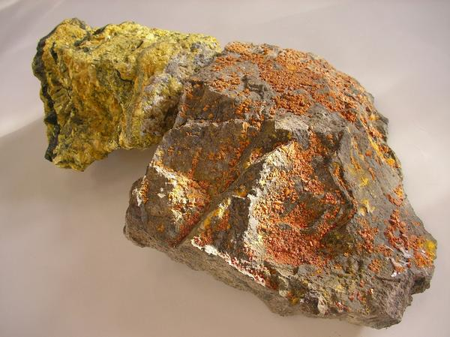
Road Blocks:
Unknown valence of As in paper
No equilibrium minerals mentioned
Not known how many, what type, and where binding sites located
K+, Na+, Ca2+
As 3+, As 5+
Where does it fit?
Complex modeling where details need to be known
http://www.webmineral.com/data/Clinoptilolite-Ca.shtml

Slide 26
Conclusion
Modeling we could do supports analytical work done in paper
Further investigation:
Modeled changes in pH
Conclusions can be drawn from this analysis
BUT…
Without additional information given in the paper, cannot get a complete adsorption model

Slide 27

Conclusion continued…
Questions?

Slide 28
References
Ruggieri, F. et al. (2008) Application of Zeolitic Volcanic Rocks for
Arsenic Removal from Water: Engineering Geology, Vol 101, pp. 245-250.
Jeon, Chil-Sung et al. (2008) Absorption Characteristics of As(V) on
Iron-coated Zeolite: Journal of Hazardous Materials.
Siljeg, M. et al. (2008) Strucutre investigation of As(III)- and As
(V)- Species bound to Fe-Modified Clinptilolite Tuffs: Microporous
and Mesoporous Materials.
Environmental Protection Agency
1) http://www.epa.gov/safewater/arsenic/basicinformation.html
2) http://www.epa.gov/region8/superfund/nd/arsenic/2008FiveYearReview.pdf
Department of Health and Human Services
http://www.atsdr.cdc.gov/csem/arsenic/exposure_pathways.html
USGS
http://minerals.usgs.gov/minerals/pubs/commodity/zeolites/zeomyb99.pdf
http://wwwbrr.cr.usgs.gov/projects/GWC_coupled/phreeqc/html/final.html
IZA – Commission on Natural Zeolites
http://www.iza-structure.org/databases/
Lenntech
http://www.lenntech.com/zeolites-structure-types.htm
WHO
http://www.who.int/mediacentre/factsheets/fs210/en/index.html

